Slide 1

Linguistic Text Steganography Using Transformer Models
By: Haya Gamal Abdel Mohsen
Supervised By: Dr. Abeer Hamdy and Dr. Khaled Nagaty

Slide 2

Table of Contents
Introduction
Related Work
Solution Methodology: Transformer Models
Generation-based Vs Edit-based
BERT Vs Roberta
Results
Conclusion

Slide 3

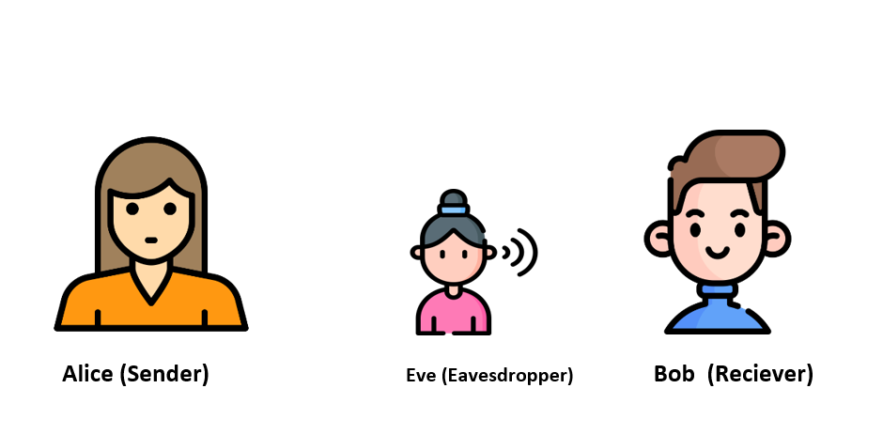
Introduction: Linguistic Steganography
Encode
“Meet Adam at 2am Room 2037”
Got it!!
Secret Message
Meet Adam at 2am Room 2037
The U.S. dollar has been a bedrock of the global economy and a reserve currency for international trade and finance.
Secret Message
Decode
Cover Text
Cover Text

Slide 4
Related Work Using Deep learning
Edit-Based Methods editing a given cover text or secret message itself to be transformed into an innocent cover text
Part-of-Speech Tagging in NLP (B. Gupta and S. Kumar, 2018) Keeping the original meaning of the cover text by lexical substitution which is replacing a word by a word of the same part of speech tags.
Cover Text: “February comes in the winter season”
Secret Text: “meeting is in January”
Steganographic text: “January is in the meeting season”
Cons:
Outputs a steganographic text of poor structural vocabulary.
Produces non context coherent steganographic texts.

Slide 5

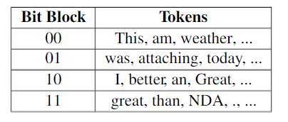
Related Work Using Deep learning
Generation-based methods Aims to directly output the steganographic text by generating a series of words based on a language model.
Generating a steganographic text using LSTM (T. Fang, M. Jaggi, K. Argyraki, 2017)
Secret Message
Vocabulary bin (Shared key)
“1000011011”
+
LSTM (LM)
Cons
Training process is very slow As parallel training cannot be performed.
Steganographic text lacks logic due to limited memory size for training (Short-memory)
Vocabulary bin (Shared key)
Output: there was a father who had to be allowed to stay overnight, night as the far- there she could hardly tell from whether the king coming and he became angry.

Slide 6
Solution Methodology: Transformer Models
1. GPT2
Generative Pre-trained Transformer 2
(released on February 14, 2019)
2. BERT
Bidirectional Encoder Representations from Transformers
(released in November 2018)
3. RoBERTa
Robustly Optimized BERT Pre-training Approach
(released in July 2019)

Slide 7
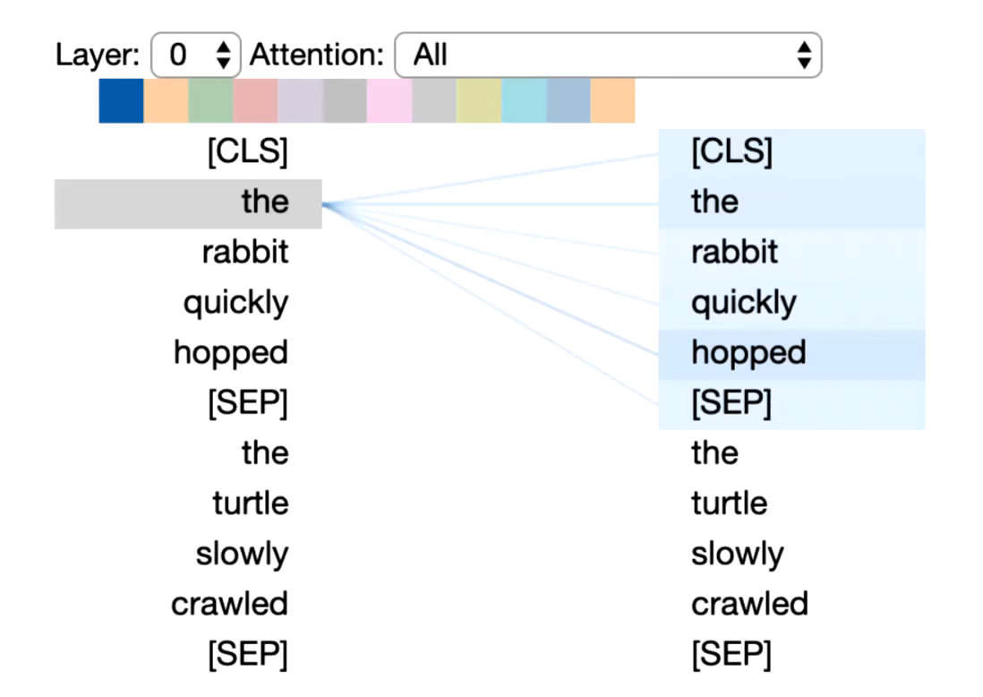




Solution Methodology: Transformer Models
Attention mechanism it is not sufficient to understand the individual words but to understand how the words relate to each other in the context of the sentence.
Multi-head attention enables the model to capture a broader range of relationships between words than would be possible with a single attention mechanism.
Q4 X ${K1}_{are}{=20\%}$
Q1 X ${K3}_{rabbit}{=80\%}$
Q1
Q2
Q3
Q4
Q5
K1
K2
K3
K4
K5
The
Rabbit
K1
K2
K3
K4
K5
are
Q4 X ${K1}_{Rabbit}{=70\%}$
Q1 X ${K1}_{are}{=50\%}$

Slide 8
Transformer Models : GPT2
Uni-Directional Decoder only auto-regressive Model
Tokenizer: Byte-Pairing Encoding
Generation-based Approach
Trained on a massive 40GB dataset called WebText (scraped all outbound link from Reddit).
List of Candidates
Steganographic Text
The dog is playing
GPT2
Bit Sequence
Decoder
Decoder
Decoder Block
Feed Forward Neural Network
Huffman Coding
Decoder
Masked Self-Attention
Secret Message
Random Word input
X
The dog is

Slide 9
Transformer Models : BERT
Tokenizer: WordPiece
Edit-based Approach
Bi-Directional Encoder only Model
Trained on BooksCorpus and Wikipedia (16 GB dataset).
[ love, hate, kill, have, …]
Masking Candidates
Steganographic Text
I hate dogs
BERT
Encoder
Bit Sequence
Encoder
Encoder Block
Feed Forward Neural Network
Encoder
Self-Attention
Huffman Coding
Secret Message
Masked Cover Text
Masking Strategy
+ Tokenizer
Cover Text
I [MASK] dogs
I like dogs
Masking: it is the process of filling out gaps represented by [MASK] token

Slide 10
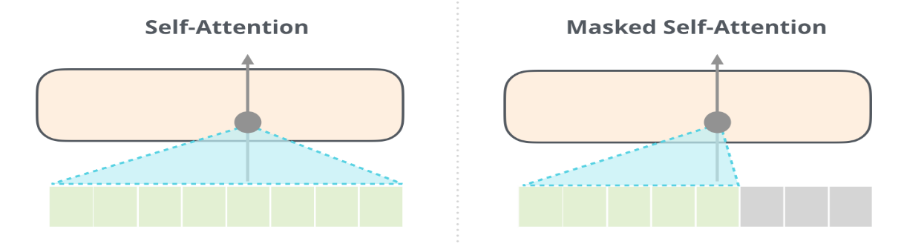
GPT2 Vs BERT
Based on: Frustratingly Easy Edit-based Linguistic Steganography with a Masked Language Model (H. Ueoka, Y. Murawaki, 2021)
Generation based Approach (GPT2) | Edit-based Approach (BERT)
Uni—directional Model | Bi—directional Model
Coverless Steganographic Method | Cover-based Steganographic Method
More payload capacity than BERT | Payload capacity is limited by cover text size
One word/sentence input | Cover text as input
Stego texts of lower Accuracy than BERT | Reasonable accuracy of the output stego text

Slide 11
Transformer Models : Roberta
Tokenizer: Byte-Pairing Encoding
Edit-based Method
Bi-Directional Encoder only Model
Trained on 160 GB (16 GB of Bert + 144 GB additional including WebText and CommonCrawl News).
‘More Data, Larger Batches size, Longer Training.’
[ love, hate, kill, have, …]
Masking Candidates
Steganographic Text
I have dogs
Encoder
Bit Sequence
Encoder
Encoder Block
Feed Forward Neural Network
Encoder
Self-Attention
Huffman Coding
Roberta
Secret Message
Masked Cover Text
Masking Strategy
+ Tokenizer
Cover Text
I [MASK] dogs
I like dogs
Masking: it is the process of filling out gaps represented by [MASK] token

Slide 12
BERT Vs RoBERTa
 | BERT | RoBERTa
Training Time | 64 TPU chips x 4 days | 4-5 times more than BERT
Performance | Outperforms GPT-2 | 2-20% improvement over BERT
Data | 16 GB BERT data (Books Corpus + Wikipedia) 3.3 Billion words | 160 GB (16 GB BERT data + 144 additional GB from GPT2 (WebText) and CommonCrawl News
Method | Masking Language Model Next Sentence Prediction | Masking Language Model
Tokenizer | Word-Piece Example: n-ug-gets | Byte-Pair Encoding (as GPT2) Example: n-uggets
Masking Strategy | Static Masking | Dynamic Masking
Reference: https://towardsdatascience.com/bert-roberta-distilbert-xlnet-which-one-to-use-3d5ab82ba5f8

Slide 13
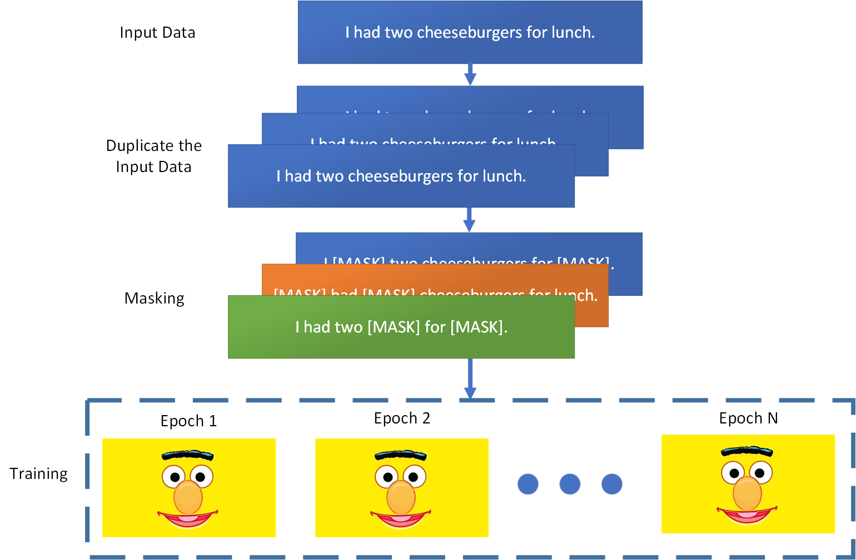
Static Masking: Bert
BERT implemented static masking by duplicating input data 10 times.
So, each input sequence is masking in 10 different ways.
During 40 epochs of training, each input sequence was seen 4 times with same mask.

Slide 14
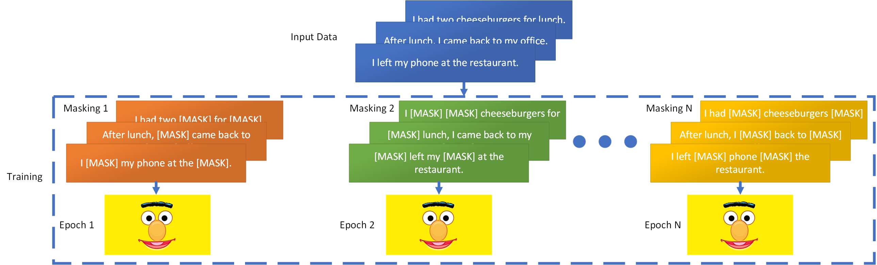
Dynamic Masking: roBerta
Dynamic masking generates new masking pattern every epoch.

Slide 15
Datasets
Edit-based Approaches (BERT and RoBERTa) Datasets
A Dataset was formulated of 100 cover texts of different domains (political, medical and academic) and of different lengths for payload capacity evaluation.
Generation-based Approach (GPT2) Datasets
3 Datasets each consist of articles of different domains (political, medical and academic) so that the GPT2 word input is randomly selected from them.
Secret Messages Dataset
A Dataset consists of 50 secret messages of different lengths for payload capacity evaluation.

Slide 16
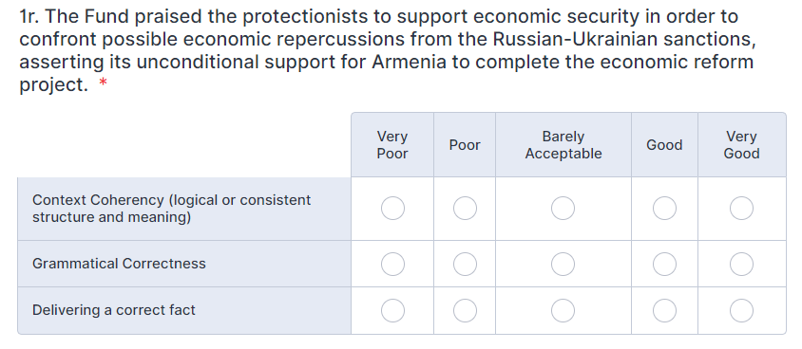
Results: Human Evaluation
The survey includes 5 steganographic texts for each model including steganographic texts of political domain, academic , medical and random topics.
34 participants have filled the survey rating each output on the mentioned domains.

Slide 17
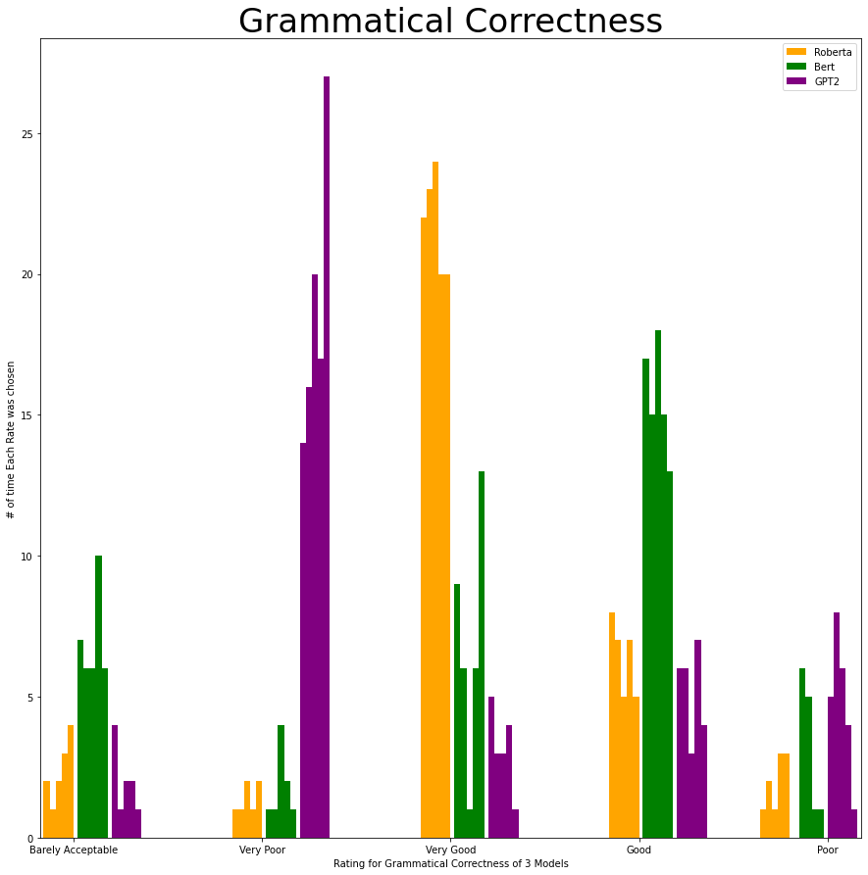
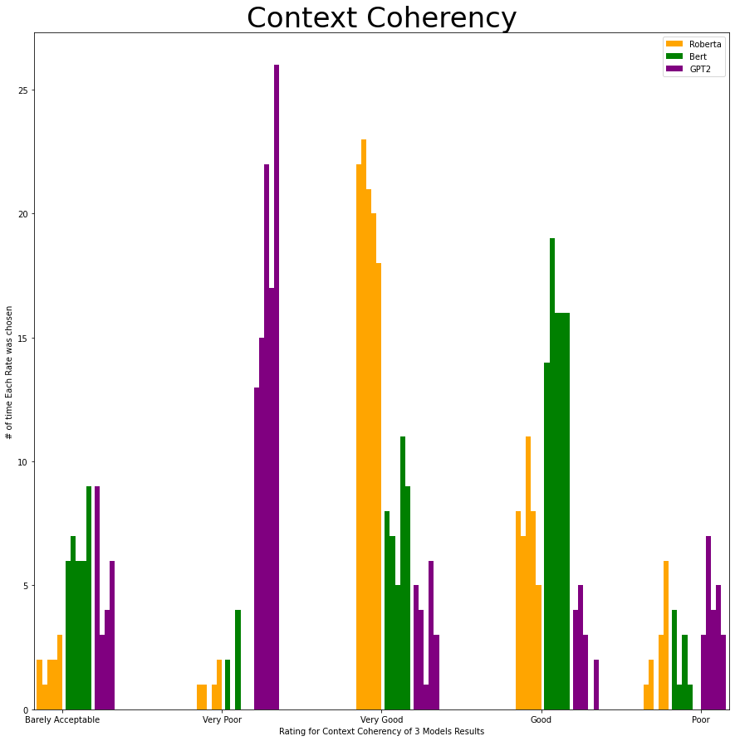
Human Evaluation Results
More than 25 participants rated GPT2 steganographic texts very poor grammatically and coherency.
20-25 participants rated RoBERTa results as very good grammatically and coherency.
BERT’s results were rated as barely acceptable to good by 5 to 15 participants.

Slide 18
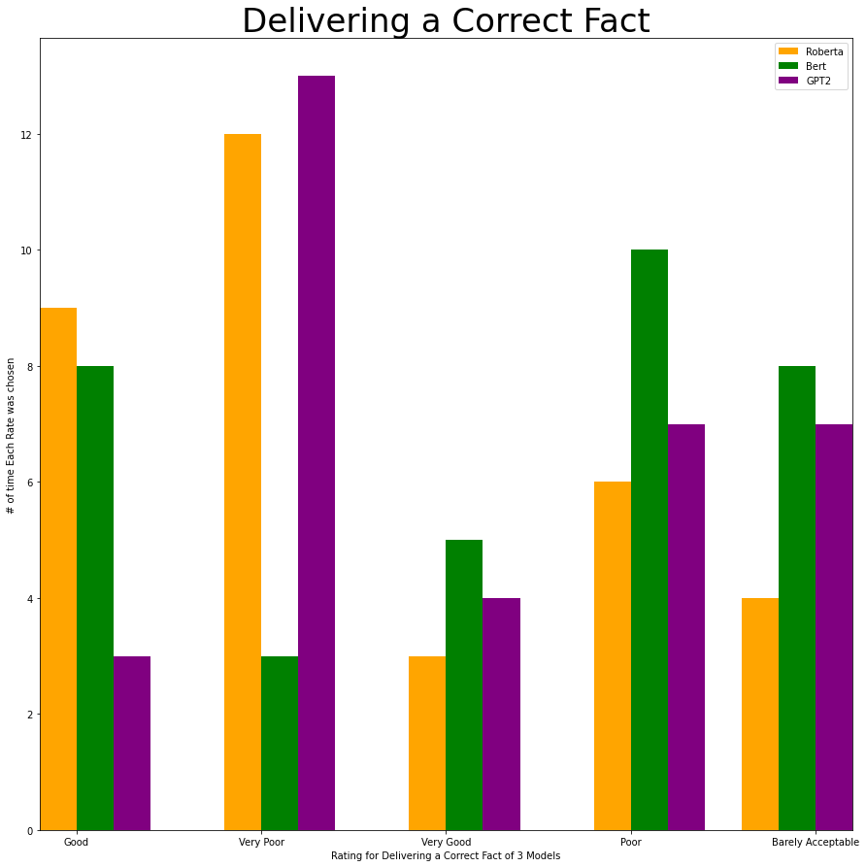
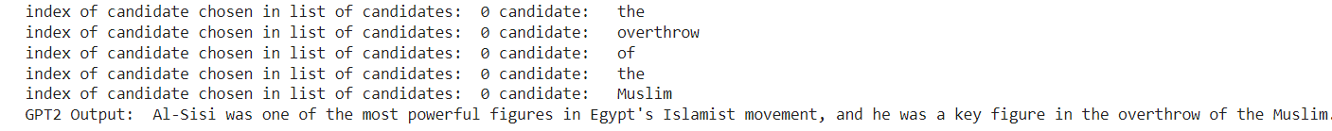
Human Evaluation Results
RoBERTa has shown the best results in terms of grammatical correctness and context coherency.
GPT2 has shown the worst results in all aspects.
Its not advisable to use the three approaches in political domain.
Example of false political fact delivering using GPT2

Slide 19
Results: Payload Capacity
4 experiments were done on the selected secret messages and the cover text datasets on 3 different masking capacity experiments.
Long Secret Message in Long Cover Text.
2. Long Secret Message in Short Cover Text.
3. Short Secret Message in Long Cover Text.
4. Short Secret Message in Short Cover Text.
30% Masking Capacity (Highest capacity)
20% Masking Capacity
10% Masking Capacity (Lowest capacity)
Secret Message | Content
Long Secret Message | Meet me at Downtown at 9
Short Secret Message | Help
Cover Text | Size
Long Cover Text | ~35-40 words
Short Cover Text | ~10-15 words
Masking Capacity: number of [MASK] tokens in cover text.
Payload Capacity: number of bits of secret message that can be encoded per word of cover text.

Slide 20
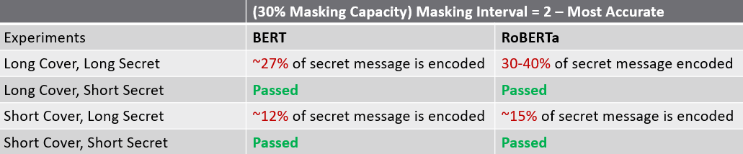
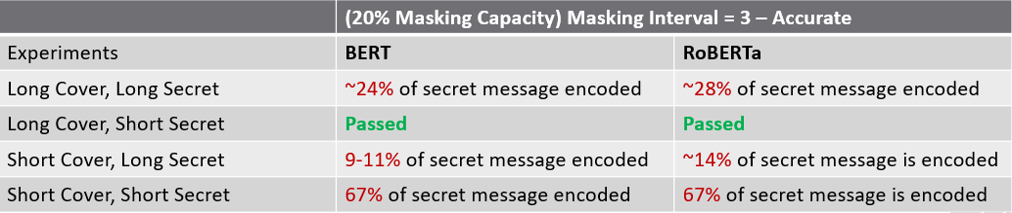
Experiment 1
Capacity Decreases
Experiment 2
Masking Interval Increases
Accuracy Decreases
Payload Capacity Results
For short secret message encoded in long cover text, both models have passed in first two experiments.
For short secret message in short cover text both models have passed in first experiment only.

Slide 21
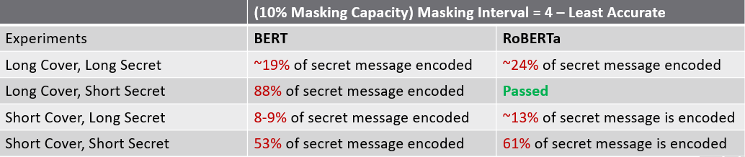
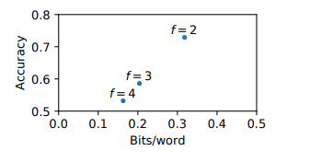
Experiment 3
Payload Capacity Results
Masking Capacity Percentage

Slide 22
Conclusion
Transformer models has shown great context coherent steganographic texts solving the suspiciousness of other model’s outputs.
Generation-based stego texts were easily detectable due to its poor structure.
However, GPT2 stego texts had the greatest payload capacity due to its unlimitedness of cover text size.
RoBERTa, newly proposed steganographic approach, showed the best results in terms of context coherency and grammatical correctness due to its Dynamic Masking.
RoBERTa in comparison with BERT, showed higher payload capacity on different masking intervals.
It is not advisable to use proposed models in political domain due to sensitivity and criticalness of information used as cover.
Future Work
Deep Testing with larger formulated datasets for the three models.
Implementing a common tokenizer from scratch acting as their vocabulary bin to solve the sub-word tokenization.

Slide 23

Any Questions? Thank you

Slide 24
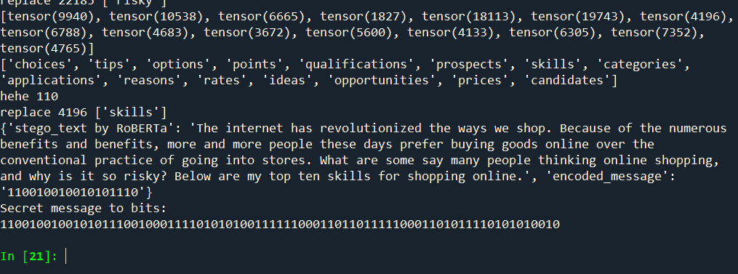
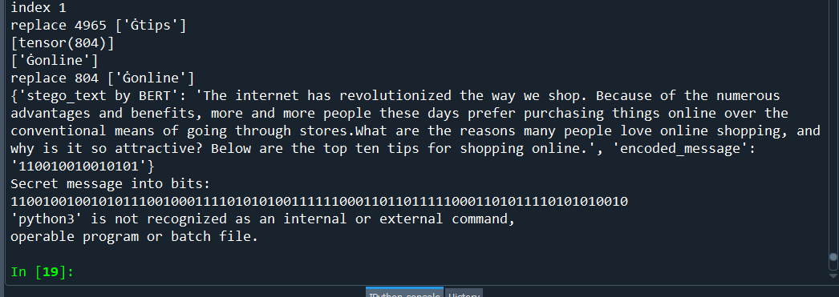
30% Masking Capacity
RoBERTa
BERT

Slide 25
References
Fang, T., Jaggi, M. and Argyraki, K., 2022. Generating Steganographic Text with LSTMs. [online] arXiv.org. Available at: <https://arxiv.org/abs/1705.10742> [Accessed 10 June 2022].
Medium. 2022. Understanding BERT Transformer: Attention isn’t all you need. [online] Available at: <https://medium.com/synapse-dev/understanding-bert-transformer-attention-isnt-all-you-need-5839ebd396db> [Accessed 10 June 2022].
E. Girling, “Everything GPT-2: 1. architecture overview,” Medium, 18-Dec-2020. [Online]. Available: https://rowlando13.medium.com/everything-gpt-2-1-architecture-overview-132d16fe985a. [Accessed: 09-Dec-2021].
Devlin, J., Chang, M., Lee, K. and Toutanova, K., 2022. BERT: Pre-training of Deep Bidirectional Transformers for Language Understanding. [online] arXiv.org. Available at: <https://arxiv.org/abs/1810.04805> [Accessed 10 June 2022].
Medium. 2022. Robustly optimized BERT Pretraining Approaches. [online] Available at: <https://towardsdatascience.com/robustly-optimized-bert-pretraining-approaches-537dc66522dd> [Accessed 10 June 2022].
B. Zain, Cs.uwaterloo.ca, 2022. [Online]. Available: https://cs.uwaterloo.ca/~mli/Bin.pptx. [Accessed: 12- Jun- 2022].

